Slide 1
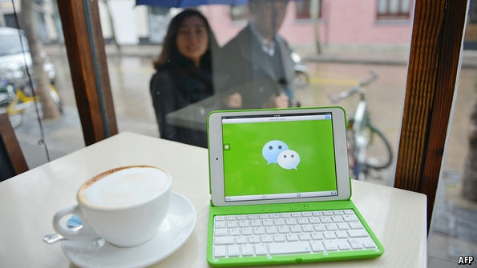
China’s Tech &
Comm Innovations
A presentation given at China’s Social Kaleidoscope 2017 Teachers Workshop, July 26-27, 2017, San Mateo County Office of Education
Professor Qingwen Dong; Department of Communication, University of the Pacific

Slide 2

“How China is Changing Your Internet”
The New York Times reporters Jonah Kessel and Paul Mozur created a five-minute persuasive video on WeChat, which illustrates the landscape in which China’s communication technology changes China and shapes the world.
https://www.nytimes.com/video/technology/100000004574648/china-internet-wechat.html?mcubz=2

Slide 3
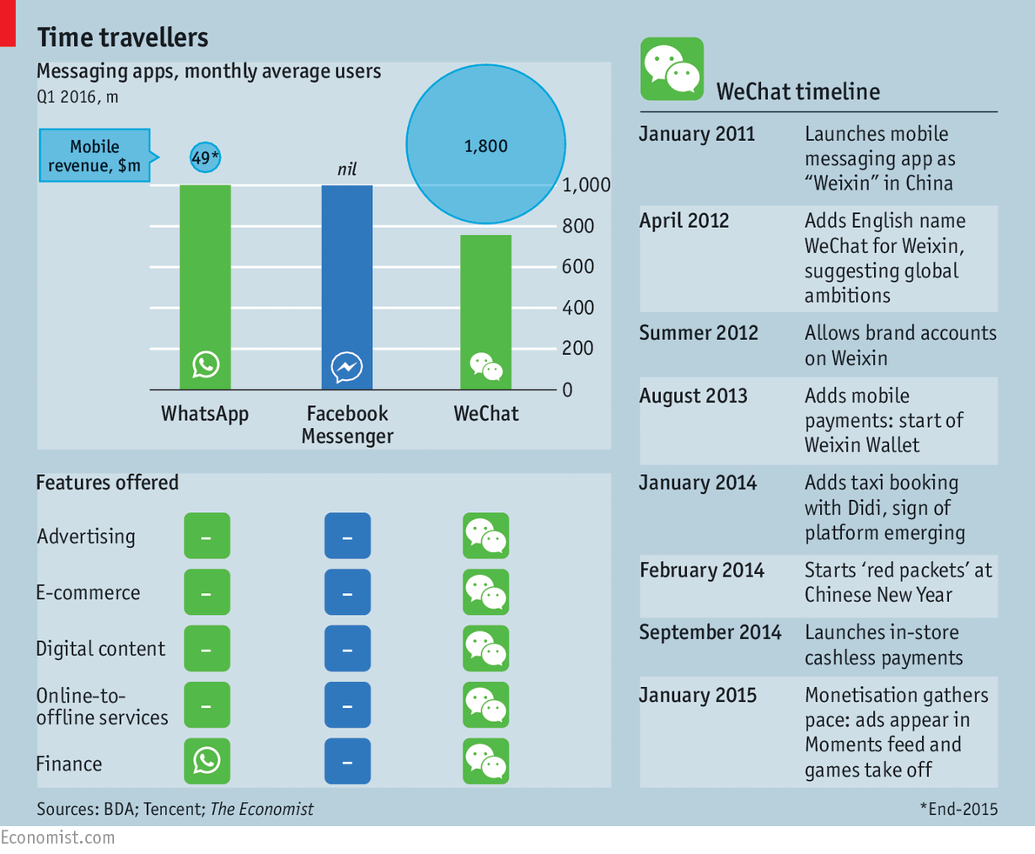

Slide 4
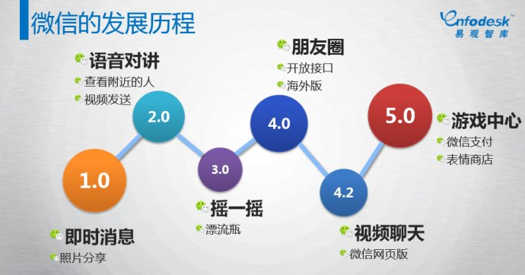
: History of WeChat Development
Set up a friend circle; overseas edition
Audio chat
Play games
Make payment
Video chat
Looking friends nearby
Instant messaging

Slide 5
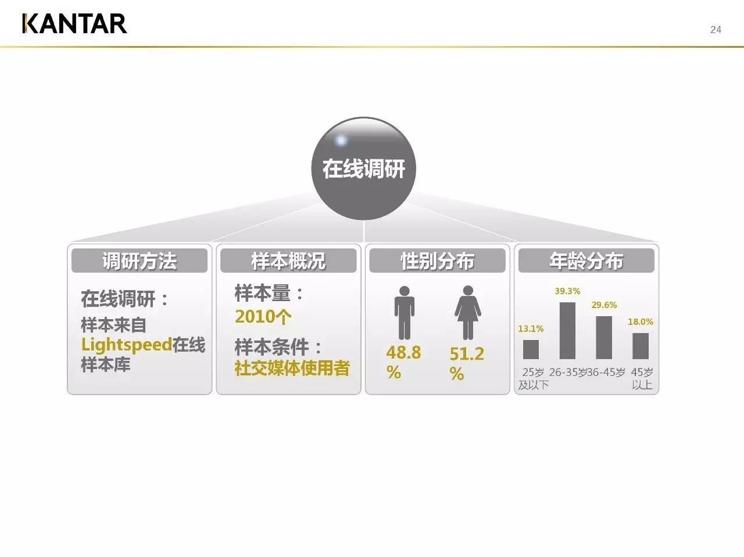
: One of the world largest Marketing Communication Groups
It conducted an online survey of 2010 social media users in China to see WeChat effects

Slide 6
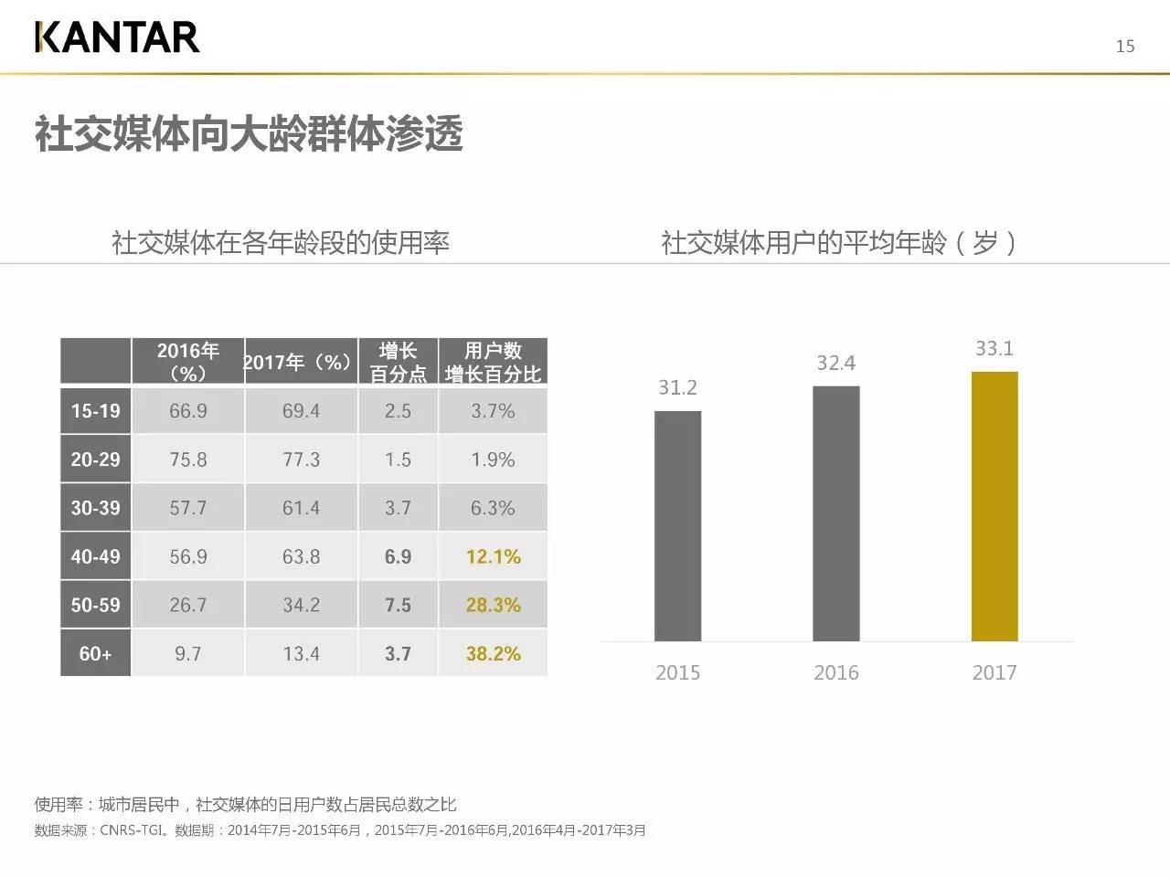
N o
Social Media penetrate into groups of middle and higher ages

Slide 7
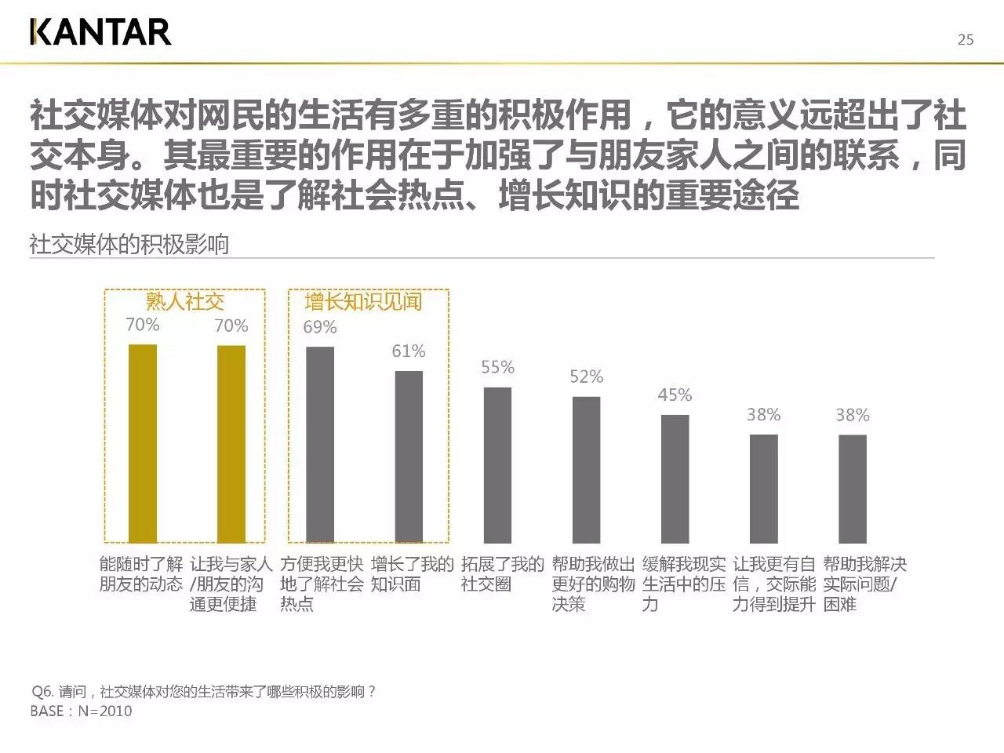
Two positive effects of social media are: 1) Social interaction between those who know each other; 2) Increase information and knowledge

Slide 8
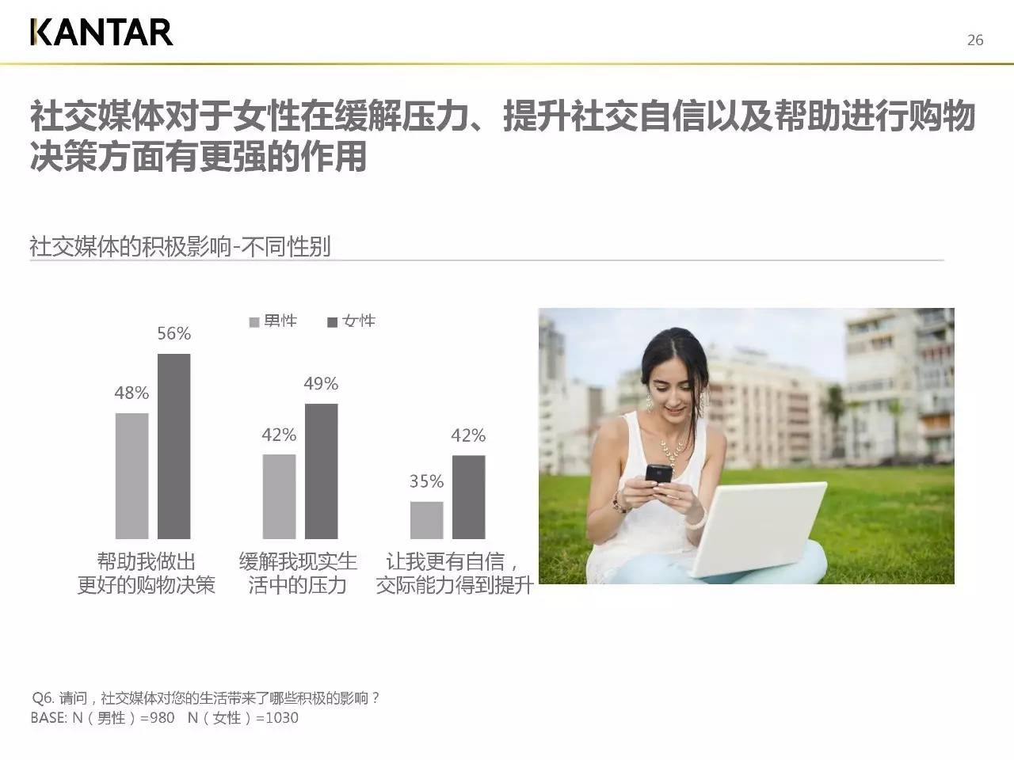
Social media help women reduce pressure, increase social interaction confidence and purchasing decision making ability

Slide 9
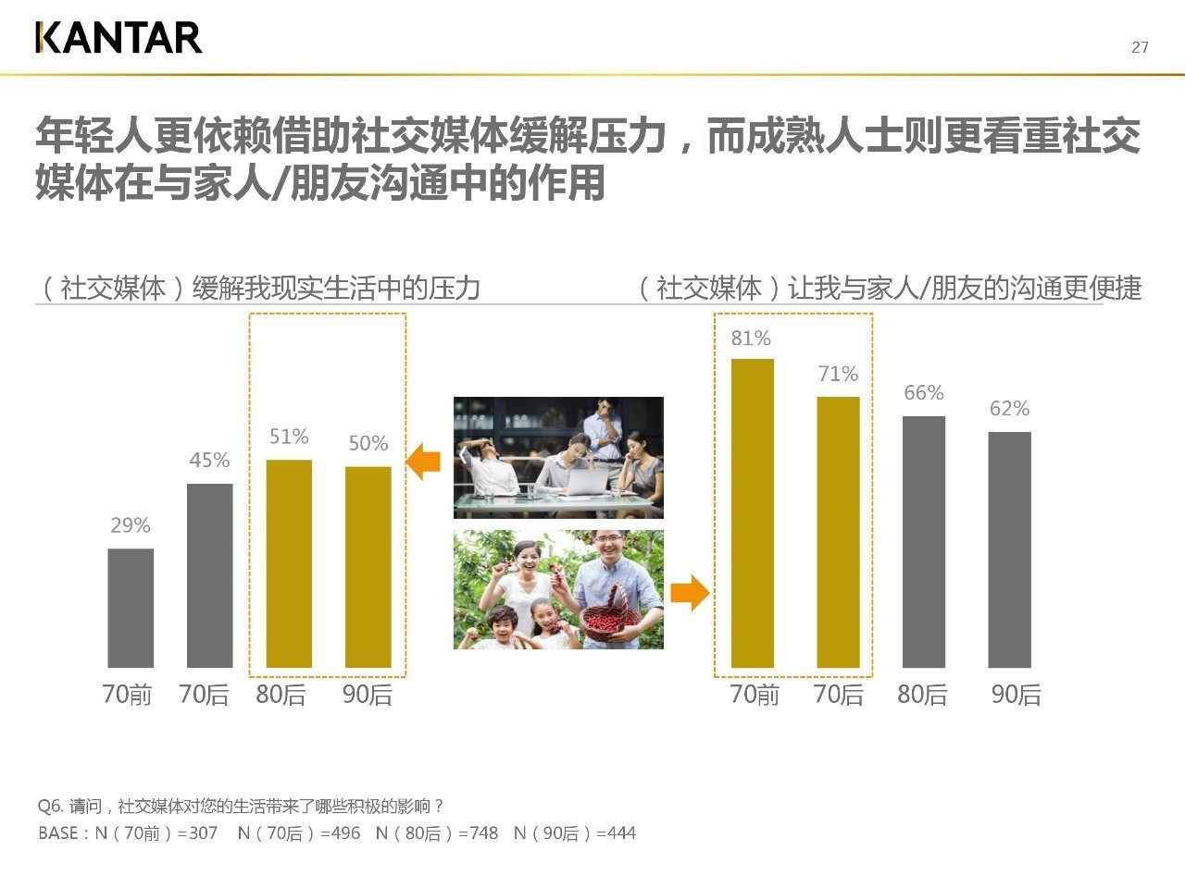
The young people depend on social media for relaxation; while the middle aged depend on social media for communicating with friends and family members

Slide 10
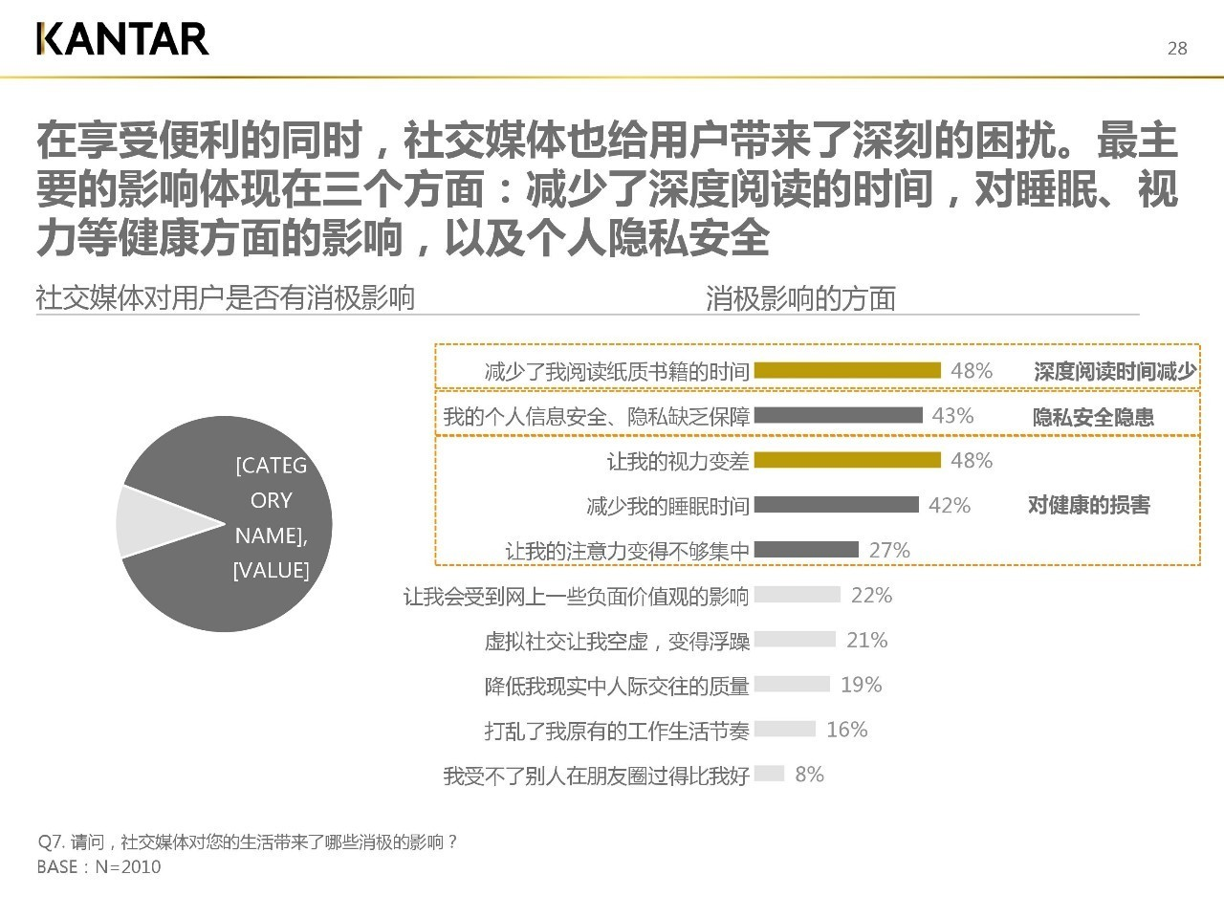
Social media three major negative effects: reducing reading time; challenging privacy protection; damaging individuals’ health including eyesight reduction, losing sleep time and lacking attention level

Slide 11
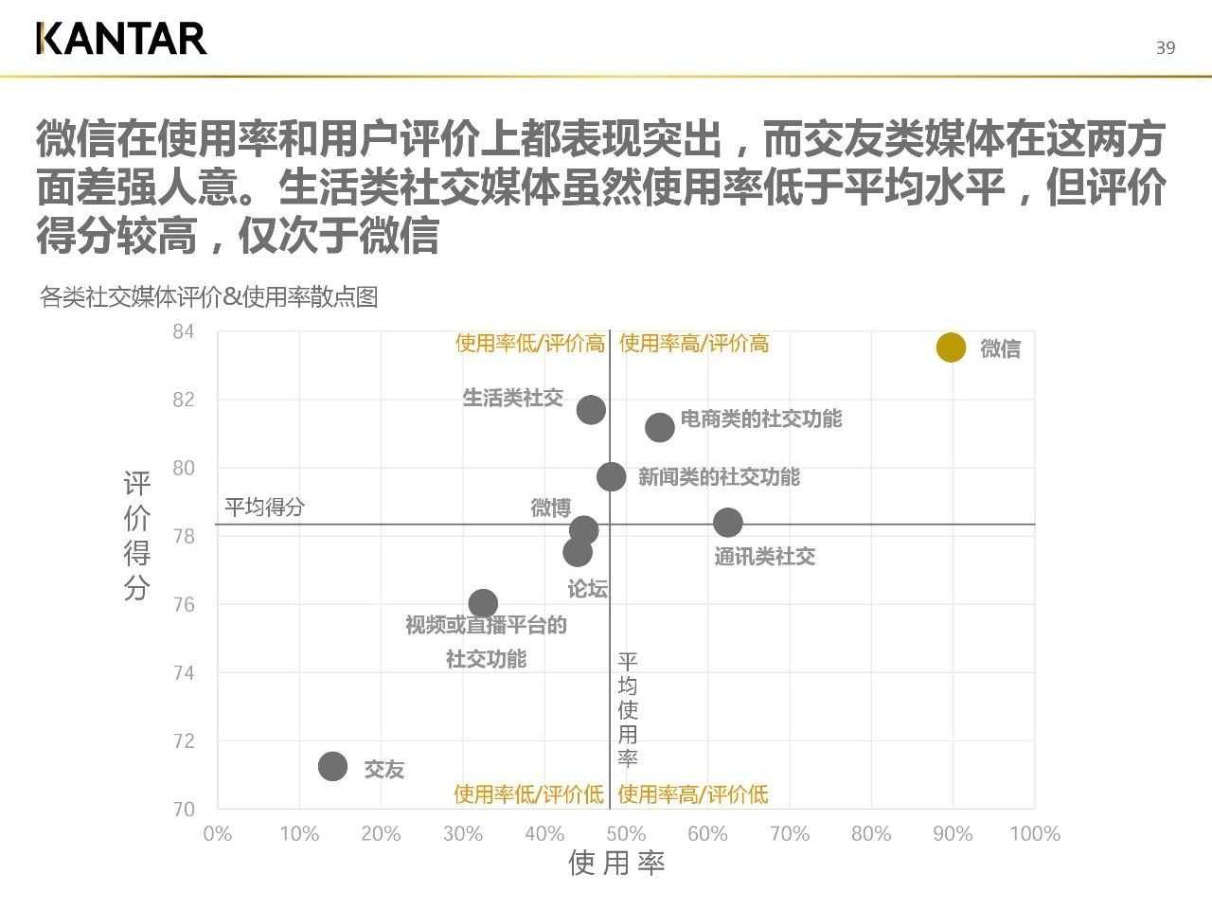
WeChat received both high rating scores and high usage scores

Slide 12
A recent report written by China Internet Network Information Center said that WeChat is designed for social communication tool, especially for those are who familiar with each others.
The report listed the following purposes for people using WeChat based on a sample of 3000 WeChat users:
1. Interact with friends 80.3%
2. Seeking news information 50.2%
3. Sharing useful information with others 49.6%
4. Gaining information for life and work 49.1%
5. Entertaining/being entertained 45.8%
6. Get to know more new friends 41.1%
7. Comments on news events 35.2%
8. Feeling belonged 29.2%

Slide 13
The report listed the frequency of using WeChat based on a sample of 3000 WeChat users:
1. Use Wechat lots of times daily 53.3%
2. Use WeChat ten times a day 87%
3. Use WeChat 4-6 times a week 91.2%
4. Use WeChat 2-3 days a week 97%
5. Use WeChat one time a week 98.6%
6. Use WeChat 2-3 times a month 98.9%

Slide 14
The report listed the length of time using WeChat based on a sample of 3000 WeChat users:
1. Use WeChat more than 60 minutes a day 59.7%
2. Use WeChat more than 30 minutes a day 75%
3. Use WeChat more than 10 minutes a day 93.1%
4. Use WeChat more than 5 minutes a day 97.9%

Slide 15
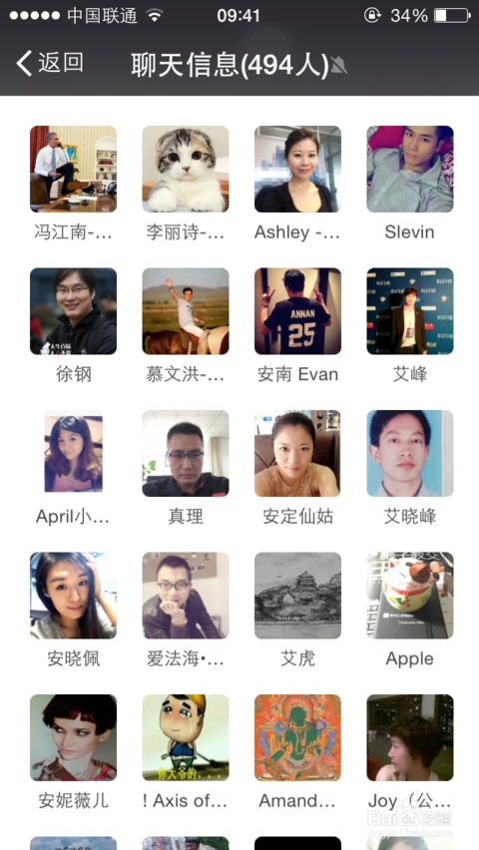
How does communication technology change
Chinese individuals?
A. WeChat becomes an effective communication tool
B. Socialization
C. Information seeking
D. Entertainment
E. Self-enhancement

Slide 16
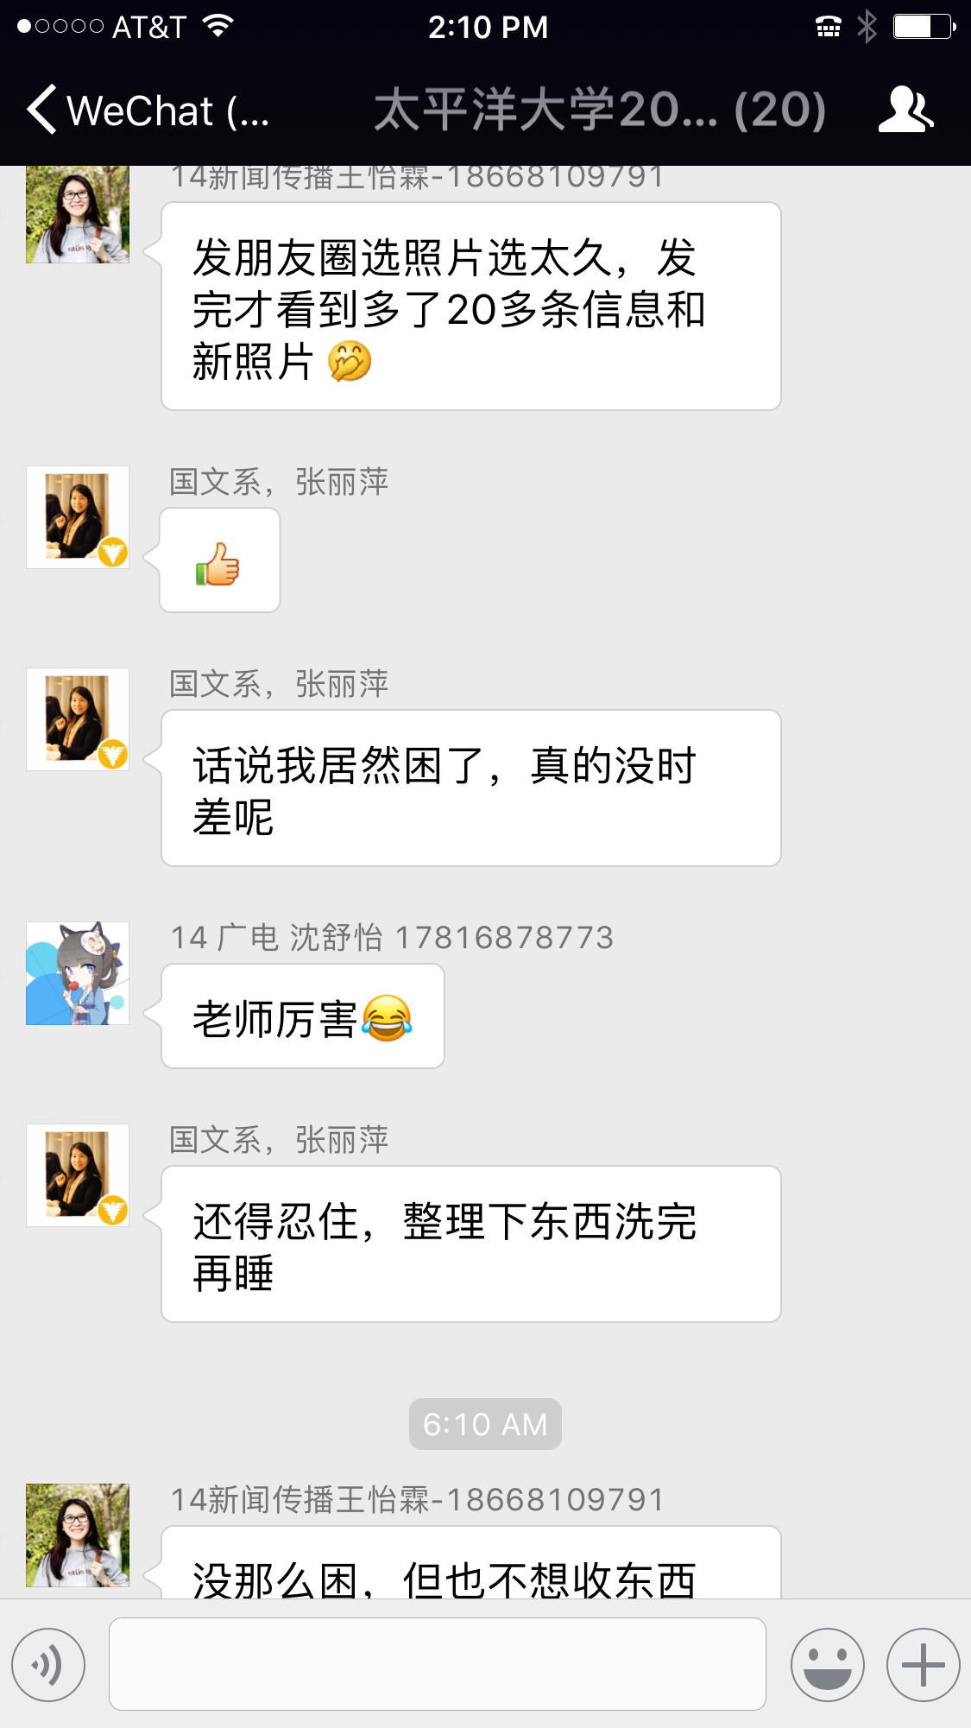
A. WeChat becomes an effective communication tool
A group of Chinese Zhejiang University students came to Pacific for a workshop this month.
First, WeChat helped discuss research proposals
Second, WeChat helped prepare the trip
Third, WeChat helped guide their trip
Fourth, WeChat helped find driver, roads & directions

Slide 17
B. Socialization
Socialization is a process in which individuals pick up values, ideals, attitudes and behaviors to become a member of the society.
Chinese fast development in communication technology offers a new and powerful socialization agent: social media, e.g. WeChat.
The most common way for people nowadays is to “build a group,” or “建个群。”
1. Group helps Chinese individuals share common interests (Jinqi cat)
2. Group helps Chinese individuals share common values
3. Group helps Chinese individuals share common goals
4. Group helps Chinese individuals share intended behaviors

Slide 18
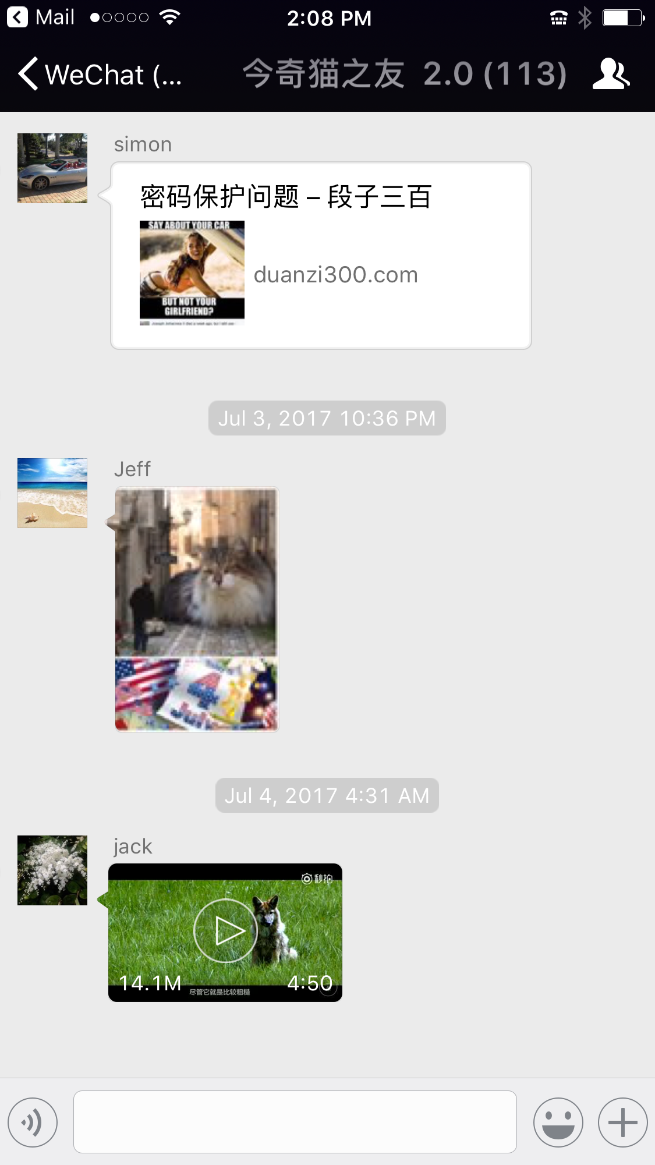
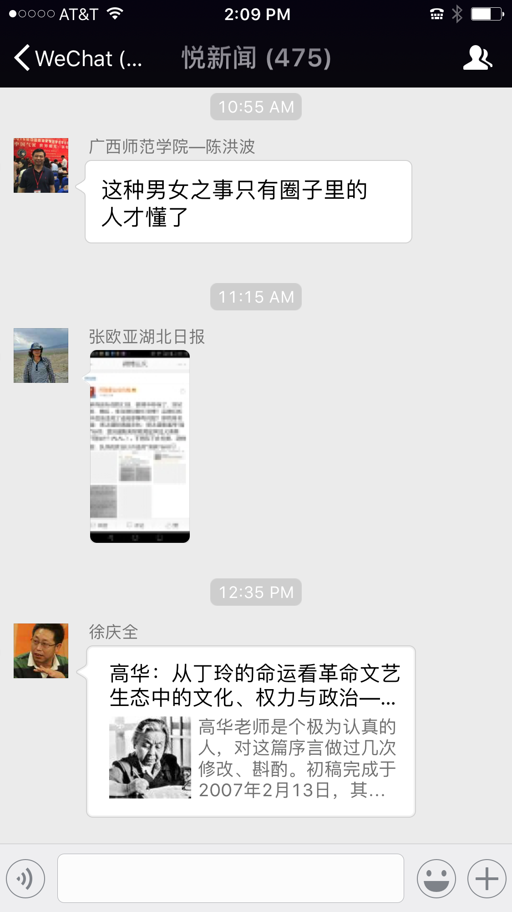
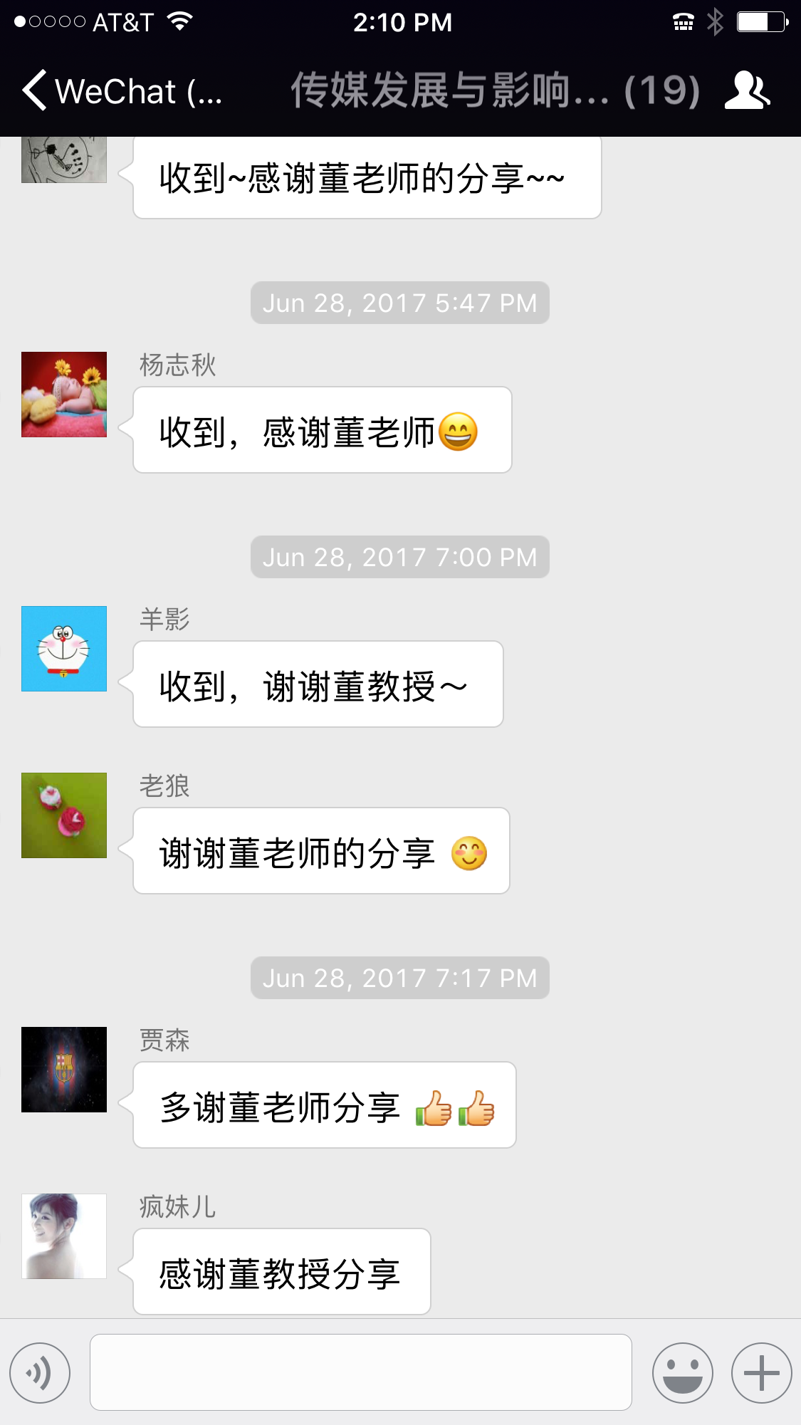

Slide 19
C. Information Seeking
Chinese communication technology offers people the fastest way to seek information. Maybe the youth now can do an excellent job in information seeking, but not necessarily doing well in retaining the information.
People use WeChat to seek all kinds of information including finding a place to live finding a place to eat finding a person to date finding a place to enjoy finding a place in which to dream about
Chinese students do not often ask “where is the library？” nowadays, instead, “do you have Wi-Fi service?” One thing people often ask is, “do you have battery charger or could you help me recharge my cell phone battery？”

Slide 20
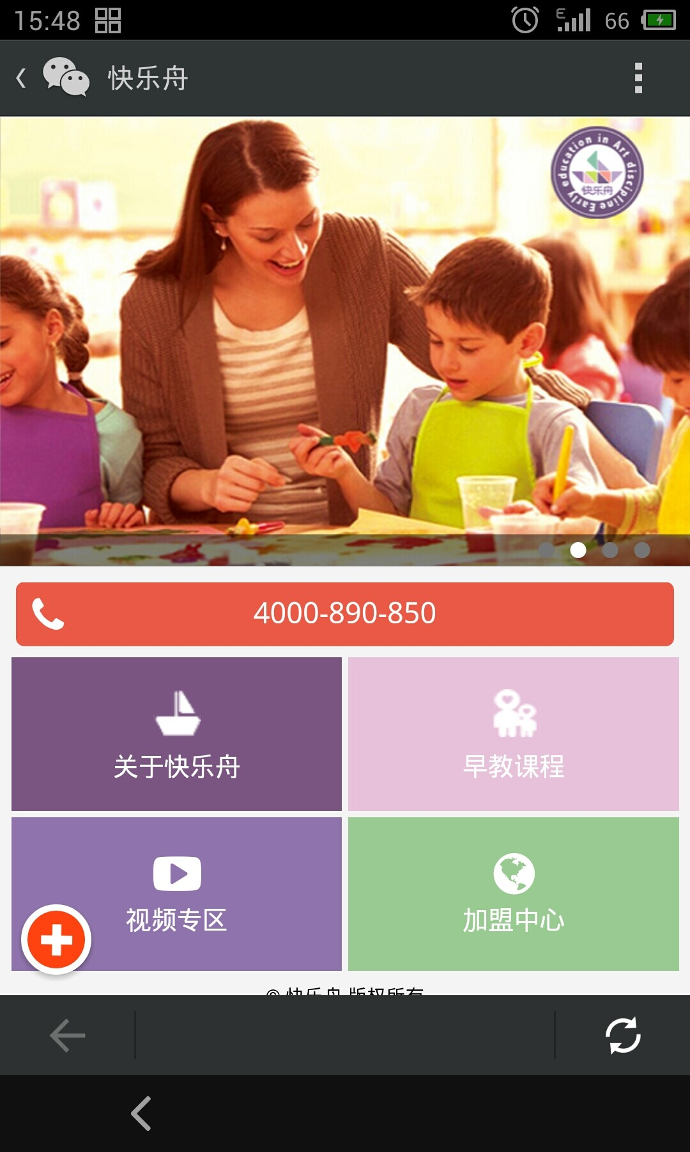
D. Entertainment
Entertainment is one of the key functions of social media.
Chinese communication technology offers individuals to entertain others or being entertained all the time.
Smart phone/WeChat becomes one of the most popular ways for entertainment because of its convenience, necessities, accessibility, and flexibility.
“Edutainment” is getting popular in education
WeChat is full of games

Slide 21
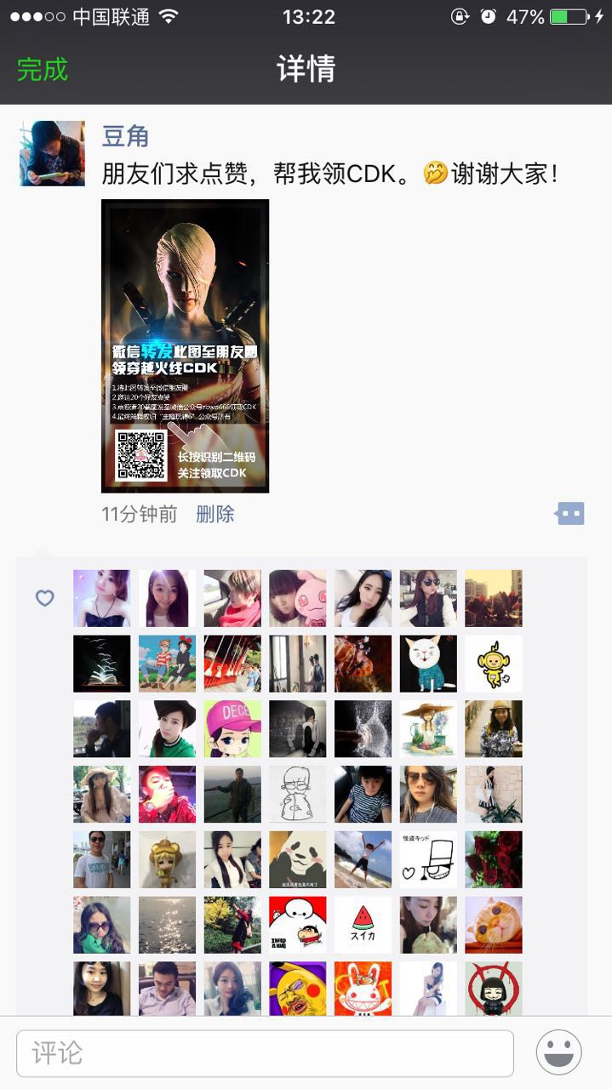
E. Self-Enhancement
One of the key features of communication technology is focusing on self, and that is why we have the word of self media.
The characteristics of these self media like WeChat is to let people themselves use the media to enhance themselves and promote themselves.
Self-centered social media offer people a brand new platform in which individuals broadcast the world by offering a better self-image, stronger self-identity, and more impressive self-esteem.
In other words, social media motivate people to get involved in using WeChat to raise their own self-image

Slide 22
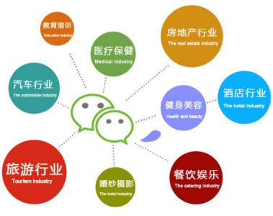
II. How does communication technology change China?
(social level)
A. Social changes
B. Economic changes
C. Educational changes
D. Political changes
Communication technology and innovations greatly transform China from a poor, weak, and disconnected country into an economic better off, strong and fully connected nation.
At the social level, communication technology, e.g., helps Chinese people make tremendous changes in society, making it a highly connected society; helping China become the second largest economic power in the world. China’s education is making great progress and political changes are also highly observable (major problems remain).

Slide 23
Communication technology impacts on social changes
Chinese people jumped over some technological stages:
Many people who never used landline phones started using cell phones directly
Many people who never used VCD started using DVD directly
Many people who never used computer to search on the Internet started directly online via smartphone
Many people who never used computer to send emails started sending messages through WeChat

Slide 24
A. Social changes
Communication technology greatly helps people get data, information, knowledge and wisdom
A scholar described how people are involved with WeChat:
“At every point of your daily contact with the world, from morning until night.”
Impacts on social changes:
1. A highly frequent social interaction;
2. More people are connected through a mobile device ;
3. People tend to be socialized by opinion leaders;
4. High explosion of information challenges media users reducing the differences between urban and rural areas;
5) Empowering minority like women, young and ethnic groups of people

Slide 25
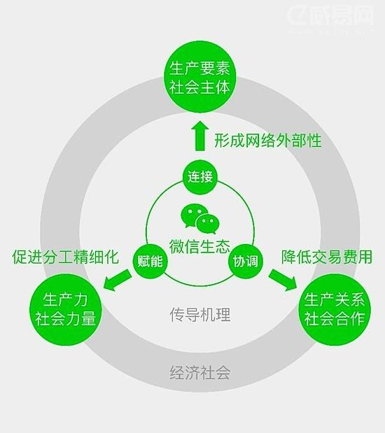
B. Economic changes
A report of The Economist said that “Among all its services,
(WeChat) it is perhaps its promise of a cashless economy, a recurring dream of the Internet age, that impresses onlookers the most.”
Chinese consumers use WeChat to pay diverse services without using cash, checks or credit cards.
WeChat earned about $1.8 billion in revenues last year.
WeChat could be worth over $80 billion.
“Three years ago, very few people bought things using
WeChat but now roughly a third of its users are making regular e-commerce purchases directly.”

Slide 26
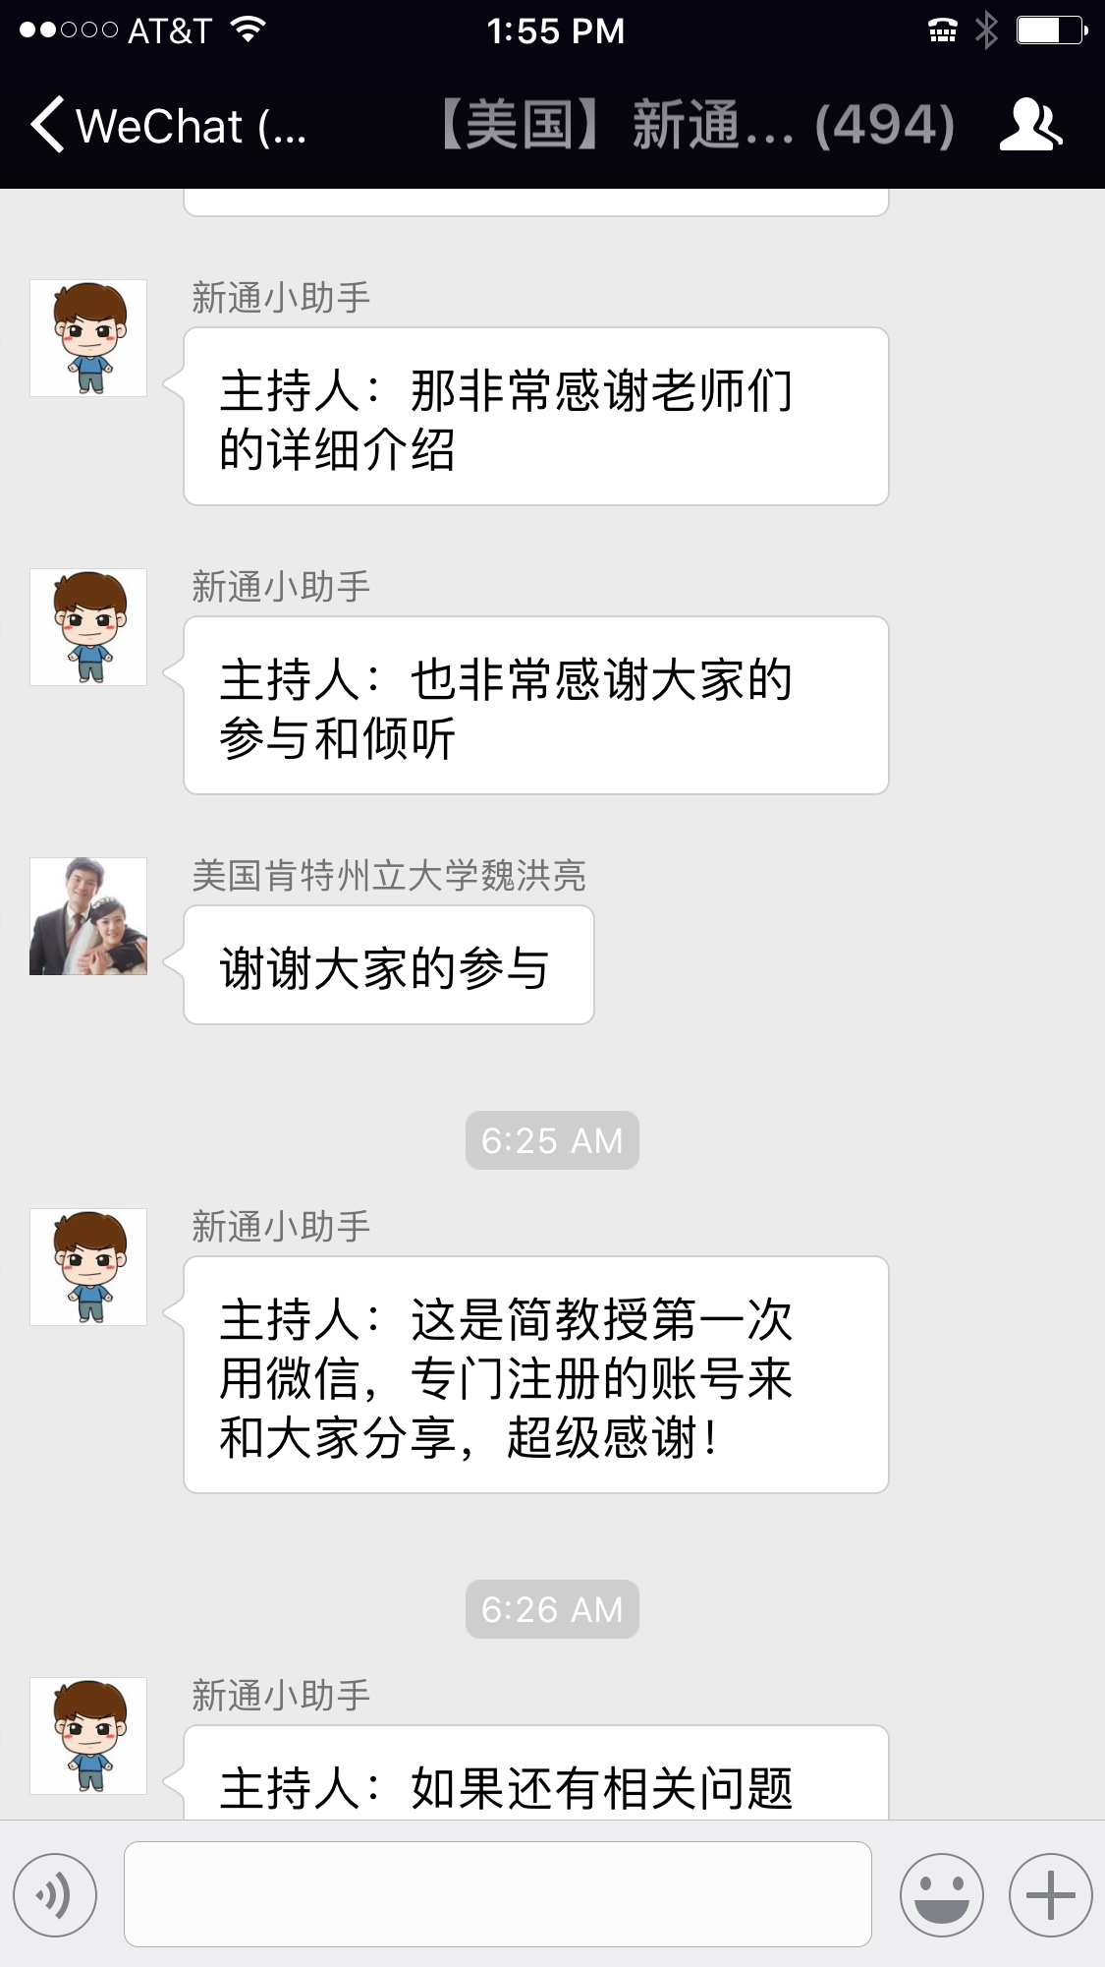
C. Educational changes
With communication technology development, WeChat helps make changes in the area of education.
1) “WeChat forum” links people across global to conduct various seminars and lectures.
2) WeChat becomes a knowledge equalizer to share knowledge and build knowledge
3) WeChat helps people recognize education opportunities and take advantage of it
4) WeChat helps raise literacy level of Chinese users

Slide 27
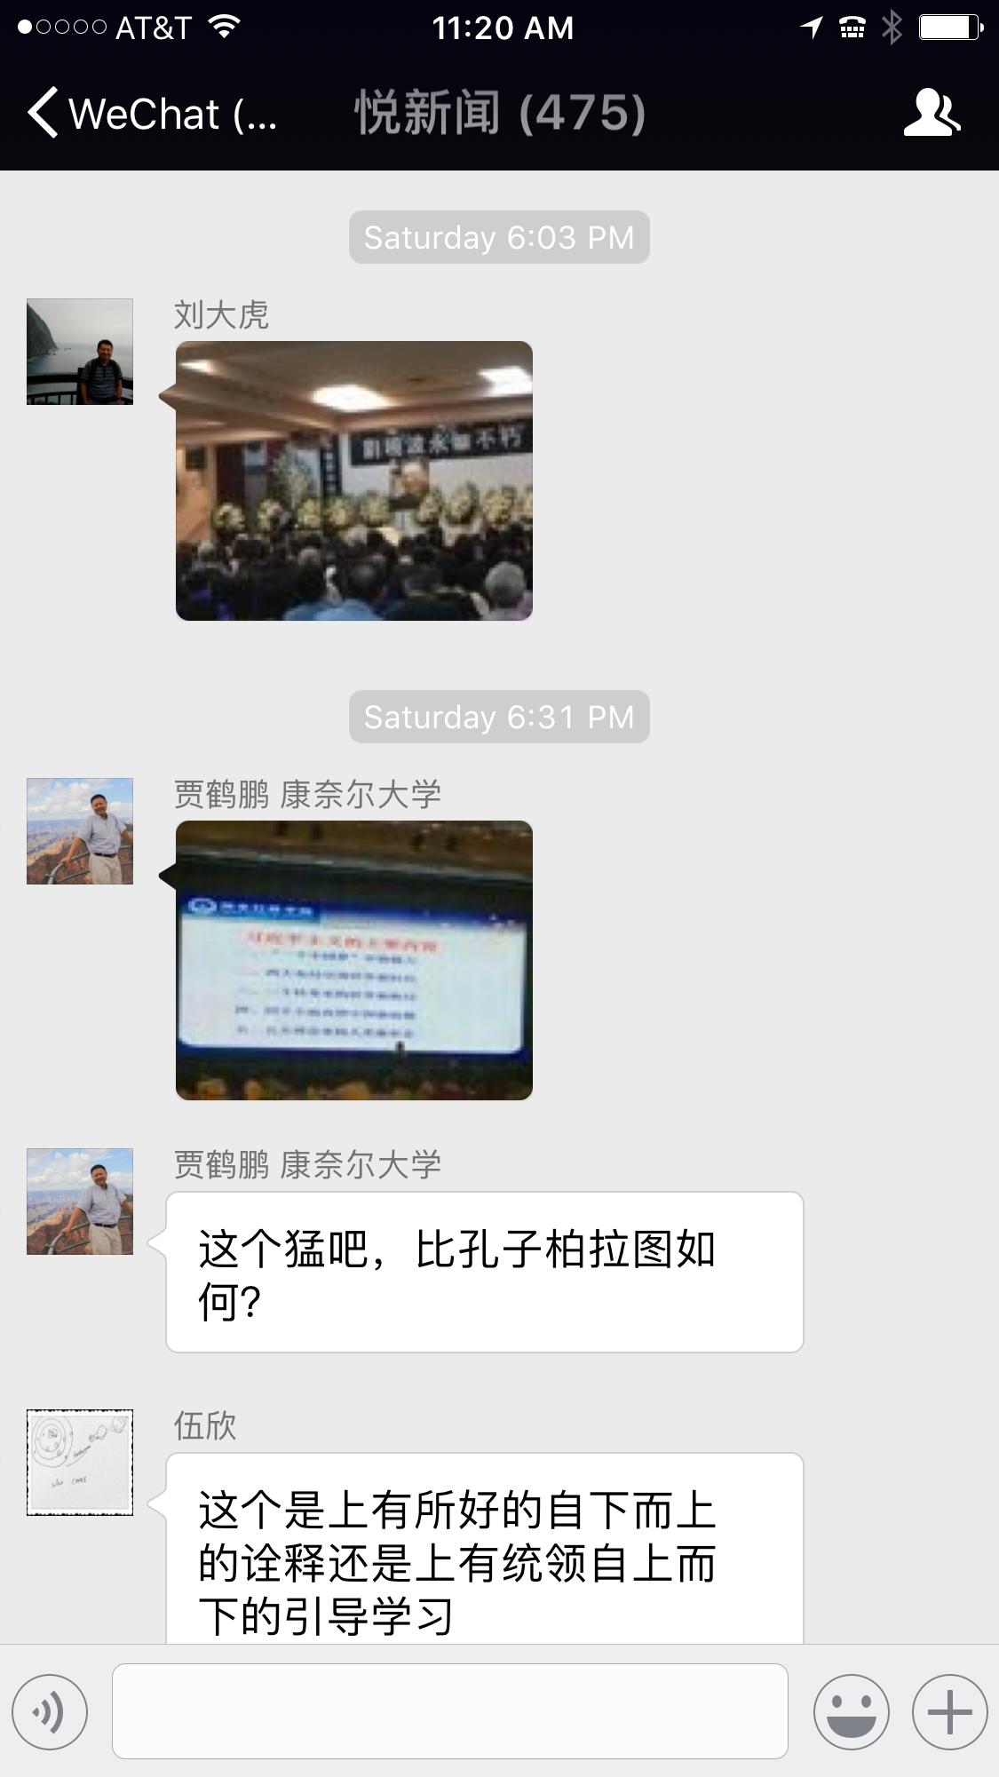
D. Political changes
WeChat helps Chinese people voice their thoughts and criticism over social media, generating a huge impact on political changes.
WeChat helps catch corrupted officials
WeChat offers a significant platform to hear the public voice
WeChat increases public political awareness
WeChat let people criticize the political system, normally they could not.

Slide 28


Slide 29
A Case study of The Influence of Social Media on Chinese College Students’ Social Activism
A study of 309 undergraduate students at a large university in Eastern China was used to answer research questions.
The main purpose of this study is to examine which factor motivates people to get involved in social activism.
*This case study is based on Xiaoting Gu’s master’s thesis.

Slide 30
Social media and Social activism
Activism is defined as “the process by which groups of people exert pressure on organizations or other institutions to change policies, practices, or conditions that the activists find problematic” (Smith, 2005, p. 5)
Yang (2010) defined online activism as contentious activities associated with the use of the Internet and other new communication technologies.
Kent (2009) social media have several unique features: moderation, interactivity, interchangeability, propinquity, responsiveness, spontaneity, and dialogue.
Chinese activist organizations take advantages of social media characteristics to use them to reach out to the public and let people participate in democratic processes.

Slide 31
Chinese activism
Activism in Western culture refers to rebellion, violence, revolt or overthrow of the government.
In this study, however, activism in China has apolitical nature and is “issue-specific” and heralds “nonpartisan advocacy.
The Chinese style activism mainly focuses on improving the society and making a better place in which human rights are respected and protected.
In almost all cases, these Chinese activists do not advocate for any issues related to overthrowing the government or the Chinese Communist Party.
We used the term of social activism to refer to having an issue-specific attitude and actively participating in popular social issues.

Slide 32
Three research questions are proposed:
1) Which motivation of using social media affects Chinese college students’ social activism? (socialization, entertainment, self-status seeking, & information seeking)
2) How does gender affect Chinese college students’ social activism?
3) How does frequency of social media use affect Chinese college students’ social activism?

Slide 33
Methods
A sample of 309 undergraduate students who enrolled in College English or Computer Science courses was used to investigate the research questions.
The questionnaire contained three sections: 1) activism orientation scale; e.g. “donate money to a social activist group,” “try to change others’ minds about a social issue?” “Participate in a discussion groups designed to discuss a particular social issue?”
2) 20 motivation statements of social media use; e.g. socialization ( get peer support from others), entertaining (kill time), self-status seeking, (make me look good), and information seeking (get academic information).
3) Frequency use of social media and other demographic variables

Slide 34
Results
RQ1) Which motivation of using social media affects Chinese college students’ social activism? (socialization, entertainment, self-status seeking, & information seeking)
Results showed that Chinese college students who use social media for information seeking, and self-status seeking tend to participate in social activism.
RQ2) How does gender affect Chinese college students’ social activism?
Results showed that gender has some impact on students’ social activism with females involved more than males.
RQ3) How does frequency of social media use affect Chinese college students’ social activism?
Results showed that frequency of social media use leads to social activism.

Slide 35
Discussion
The results of this study indicate that Chinese college students who use social media for information seeking and self-status seeking are likely to get involved in individual social activism. However, if they depend on social media for socializing, or entertainment, they do not likely get involved in social activism.
Information seeking is the key motivation for Chinese college students to participate in social activism.
Results also showed that Chinese students tend to use social media for entertainment purpose, which showed the highest level of motivation in using social media.

Slide 36
Some Takeaway
1.China’s technology and communication innovations are getting into a leading position (e.g. WeChat)
2. China’s communication technology plays a key role in helping Chinese economy as well as shaping world economic activities
3. Social media like WeChat continue playing a critical role in socializing Chinese people as well as cultivating changes in the Chinese society
4. Though social media have several negative effects (retention, privacy, and health), they are critical to economic, social and political development in China

Slide 37

Thanks

